Slide 1
Vision Quest
A study in Robotic vision acquisition and simulation modeling

Slide 2
Project Outline
Knowledge acquisition on:
Robot Simulation
ROS programming
Point Cloud image capture
Levering off the shelf tools, services, and technology, build a tutorial on the basics of ROS programming and Point Cloud image capture and share it with others.

Slide 3
Project Plan
Building on acquired knowledge
Developing new scope of integration
Document and Deploy example of the journey
Systems Identification
Software Setup
Hardware Setup
Integrated Solution

Slide 4
Discovering the Robotic World
Software
Virtual OS Linux on Windows
Robot Simulation
Hardware
IR Vision Camera
Data Capture (PI)
Interface to PC
Solution
Point Cloud Translation
Image import
Simulation Obstruction Avoidance
Identifying resources, tools and services for integration. Acquire, Design, and Develop knowledge to deliver an integrated solution.

Slide 5
Components Architecture
Software
VirtualBox (VM)
ROS Indigo (Turtle Simulator) and RVIZ
Hardware
PC
Raspberry PI
OS
Windows
Ubuntu Linux 14.04
Kinect Camera

Slide 6
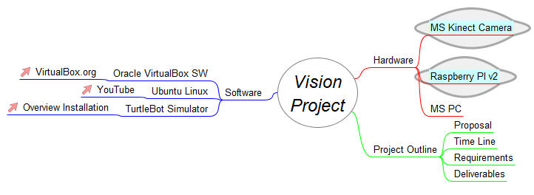
Vision Quest MindMap

Slide 7
Key Process Components
Discover
Deploy
Integrate
Test and Implement

Slide 8
OS
Windows/IoS VirtualBox installation

Slide 10
Hardware
PC, Raspberry PI, Kinect Camera

Slide 12
Software
VirtualBox and ROS (Turtle Simulator)

Slide 14
Add a Slide Title - 2

Slide 16
Add a Slide Title - 4

Slide 17
Add a Slide Title - 5

Slide 18
Title and Content Layout with Chart

Slide 19
Title and Content Layout with Table
First bullet point here
Second bullet point here
Third bullet point here
Class | Group 1 | Group 2
Class 1 | 82 | 95
Class 2 | 76 | 88
Class 3 | 84 | 90

